Slide 1



Software Engineering CS411, FALL 2025
Black-Box Testing by Prof. Mohamad Kassab
Leonidas Kontothanassis kthanasi@bu.edu

Slide 2

https://www.bu.edu/cds-faculty/2024/03/25/announcing-industry-connections-speaker-series/

Slide 3
Agenda
Functional Testing
Boundary Testing
Equivalence Class Testing
Decision Table – Based Testing
All-Pairs Testing

Slide 4
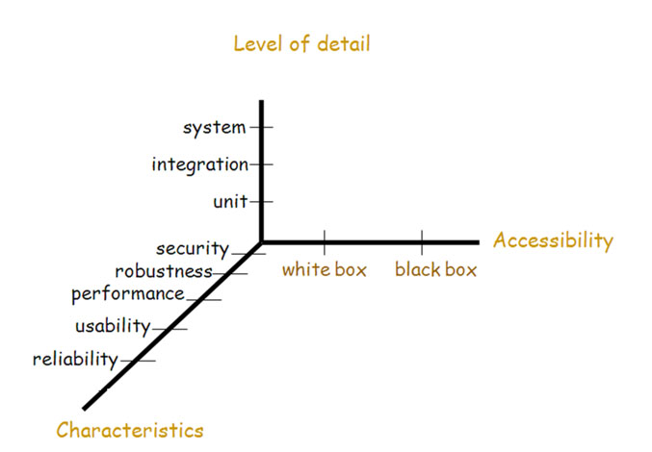
Testing Dimensions

Slide 5
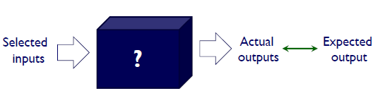
Functional Testing
A program can be considered as a function that has inputs as a domain and outputs as a range
Historically functional testing emphasized the input domain but it can be apply for range based test cases as well
Is not based on the structure of the program (which is unknown)
Notes:
Test cases are selected based on functional specification

Slide 6
Boundary Value Testing
Boundary value testing is a software testing technique used to evaluate the behavior of a system at the boundaries of input domains. The basic premise is that errors often occur at the edges or boundaries of input ranges rather than within the range itself.

Slide 7
Boundary Value Analysis
Boundary Value Analysis:
based on “single fault” assumption in reliability theory
The input variable values are used at their min, min+, nom, max-, max
Notes:
A method of dividing application systems’ input domain into segments so that testing can occur within the boundaries of those segments.
“Failures are rarely as a result of the simultaneous occurrence of two (or more) faults”

Slide 8
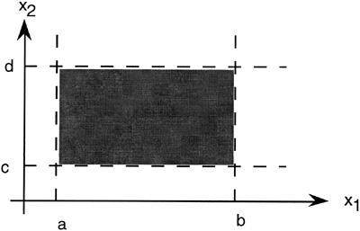

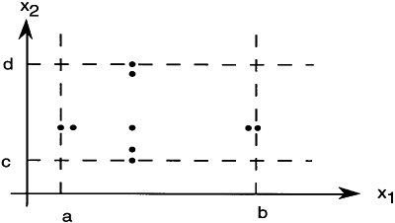
Boundary Value Analysis
Having a function F of x1 and x2:
Boundary value analysis test cases will be:
T = { <x1nom, x2min>, <x1nom, x2min+>, <x1nom, x2nom>, <x1nom, x2max->, <x1nom, x2max->, <x1min, x2nom>, < x1min+, x2nom>, <x1max-, x2nom>, <x1max, x2nom> }
n variables yield 4n+1 test cases
Notes:
Idea is to keep all but one variable at nominal value and and try all options for the one being tested.

Slide 9
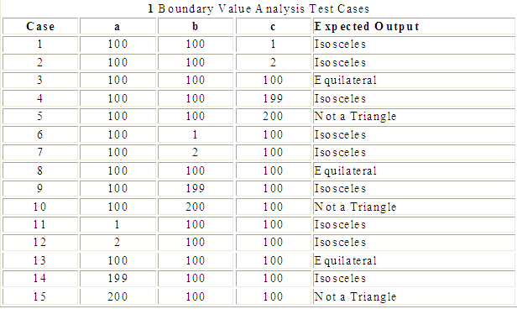
Triangle Example
No conditions are specified on the triangle side, other than being integers, the lower bound of the ranges are all 1. We arbitrary take 200 as an upper bound

Slide 10
Boundary Value Analysis
Can be applied to loop control variables, indices, pointers
Choose also inputs that invoke output boundary values ( values on the boundary of output classes )
Limitations:
Works well for functions of several independent variables that represent bounded physical quantities
No consideration of the nature of the function nor the semantic meaning of the variables

Slide 11
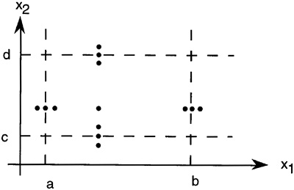
Variation: Robustness Testing
Explicit range checking and exception handling
In addition to the five values of the variable we add two more:
slightly greater than the maximum (max+)
slightly less than the minimum (min-)

Slide 12
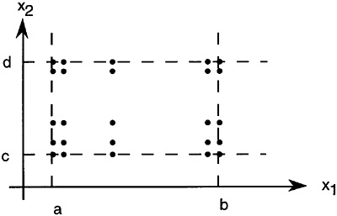
Variation: Worst-Case Testing
Rejection of the single fault assumption
For each variable, we have min, min+, max, max+ and then we take the Cartesian product of these sets to generate test cases
For n input variables the number of test cases is 5^{n}

Slide 13
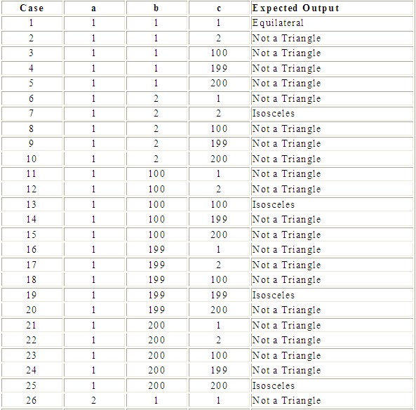
Example Worst-Case Test Cases (Triangle program)
Worst-Case test cases (one “corner” of the input space cube)

Slide 14
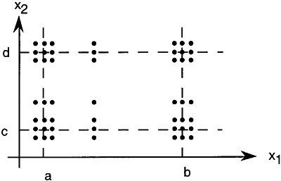
Variation: Robust Worst-Case Testing
Add max+,min-
For n input variables the number of test cases is 7^{n}
^{(paranoid!)}

Slide 15
Guidelines for Boundary Value Testing
Test methods based on the input domain of the program (Function) are rudimentary
They assume that the input variables are independent and when they are not the result is not satisfactory
Distinctions
Normal versus robust values
Single fault versus multiple fault assumption
They can be applied to the output range of the program

Slide 16
Output Boundary Testing
When the output has interesting boundary conditions that correspond to certain non-boundary input ranges
Examples: Income range tax computations, response size/detail based on load, physical controller behavior based in input value ranges, etc.
The idea is to confirm that output is correct in those boundary transition situations.

Slide 17
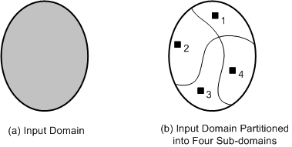
Equivalence Class Partitioning
An input domain may be too large for all its elements to be used as test input
The input domain is partitioned into a finite number of subdomains
Each subdomain is known as an equivalence class, and it serves as a source of at least one test input
A valid input to a system is an element of the input domain that is expected to return a non error value
An invalid input is an input that is expected to return an error value.

Slide 18
Equivalence partitioning
Notes:
What is Equivalence partitioning? Equivalence partitioning is a method for deriving test cases. In this method, equivalence classes (for input values) are identified such that each member of the class causes the same kind of processing and output to occur. The # of test cases can be limited to one-per-class, which represents the minimum # of test cases that must be executed.
E.g.- valid data range: 1-10 Test set:-2; 5; 14

Slide 19
Guidelines for Equivalence Class Partitioning
An input condition specifies a range [a, b]
one equivalence class for a < X < b, and
two other classes for X < a and X > b to test the system with invalid inputs
An input condition specifies a set of values
one equivalence class for all elements of the set {M₁}, {M₂}, ...., {M_{N}}, and
one equivalence class for elements outside the set {M₁,M₂, ...,M_{N}}
Input condition specifies for each individual value
If the system handles each valid input differently then create one equivalence class for each valid input
An input condition specifies the number of valid values (Say N)
Create one equivalence class for the correct number of inputs
two equivalence classes for invalid inputs – one for zero values and one for more than N values
An input condition specifies a “must be” value
Create one equivalence class for a “must be” value, and
one equivalence class for something that is not a “must be” value

Slide 20
Equivalence Partitioning Exercises
1. 0 <= X <= 100
2. The month of the year
3. Type of a vehicle must be bus, truck, taxi or car
4. The first character of an identifier must be a letter
Notes:
1. range, 3 partitions: X < 0 , X>100, X in range 2. set of values, 2 partitions: 1-12, any other number
3. Individual values, 5 partitions: bus, truck, taxi, car, something else 4. Must be specification, 2 partitions
5. Nothing for number of inputs in this example

Slide 21
Advantages of Equivalence Class Partitioning
A small number of test cases are needed to adequately cover a large input domain
One gets a better idea about the input domain being covered with the selected test cases
The probability of uncovering defects with the selected test cases based on equivalence class partitioning is higher than that with a randomly chosen test suite of the same size
The equivalence class partitioning approach is not restricted to input conditions alone – the technique may also be used for output domains

Slide 22
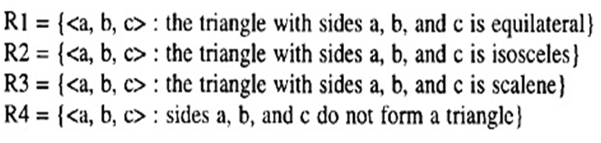
Equivalence partitioning of output variables example: Triangle Problem
We note that four possible outputs can occur:
Not-A-triangle, Scalene, Isosceles, Equilateral.
These are used to identify output range equivalence classes

Slide 23
Technical Method for deriving test cases from Requirements Specification based on Logic: Decision Table
Uses a tabular format to map the logic behind a decision-making process
Display a combination of conditions to be met and actions to be taken
Single condition/action:
If there is smoke (condition) then push the fire alarm (action)
Notes:
It is an extremely powerful device for viewing complex judgments in a tiny format.

Slide 24
Illustration of the use of a decision table (Pressman)
Three types of customers are defined: a regular, a silver customer, and a gold customer.
A regular customer receives normal print rates ad delivery.
A silver customer gets an 8% discount on all quotes and is placed ahead of all regular customers in the job queue.
A gold customer gets a 15% reduction in quoted prices and is placed ahead of both regular and silver customers in the job queue.
A special discount of x% in addition to other discounts can be applied to any customer’s quote at the discretion of management.
Notes:
These types are assigned by the amount of business the customer does with the print shop over a 12-month period

Slide 25
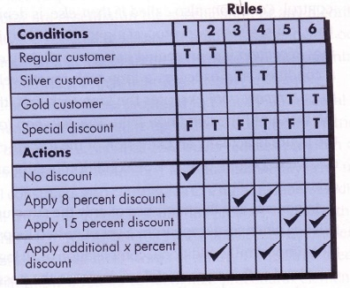
Solution?

Slide 26
Constructing a Decision Table
List all actions that can be associated with a specific usage of the software system
List all conditions during the usage
Associate specific sets of conditions with specific actions
Define rules by indicating what action(s) occurs for a set of conditions

Slide 27
Pair-wise Testing (All-Pairs Testing)

Slide 28
All-Pairs Testing – the Basic Idea
What does it mean to "combine all pairs"?
Consider a function with 3 parameters p1, p2, p3 and possible values of 0,1 for each
(A) "All values appear once" → two test cases
(B) "All combinations appear once" → 2^n = 8 TCs
(C) "All value pairs": Only generate all combinations for parameter pairs (p1-p2, p1-p3, p2-p3) and 'merge them into test cases'
Each possible pair of (p_{i}-p_{j}) is included in one of the 4 All-Pairs test cases
(A) All values appear once
(B) All combinations appear once
(C) All value pairs appear once
P1
P2
P3
P1
P2
P3
P1
P2
P3
0
0
0
0
0
0
0
0
0
1
1
1
0
0
1
0
1
1
0
1
0
1
0
1
Not effective
0
1
1
Not efficient
1
1
0
1
0
0
1
0
1
Efficient & Effective
1
1
0
1
1
1
Notes:
What does it mean to combine all pairs?
What is all-pairs? Look at the 3 tables and consider:
What are 'variable pairs'? (p1,p2) ; (p2,p3) ; (p1,p3)
For each of these variable pairs, all possible value combinations (00, 01, 10, 11) need to be covered and included in the test case (i.e. set of all TC variants)
Left table: Each value appears only once.
Middle table: full combinatorics, all combinations
Right table: "Each 'value pair' appears at least once" (in this case, 'exactly once')
Each test case variant (one row) contains 3 value pairs: (p1,p2) ; (p2,p3) ; (p1,p3), ie. covers 3 value pairs
You will find each possible combination of value pair, e.g. "p1,p3 = 0,1" in one of the rows of the all-pairs table (bottom right). (here: variant 2 = row 2)
Another way to look at it: If you only consider two parameters and look only at those columns, you will find all value combinations (00, 01, 10, 11) in the rows.
Why is (1,1,1) is not there? Because the pairs (-,1,1), (1,-,1) and (1,1,-) are already covered in existing cases and we care only about pairs and not triples.
The savings between full combinatorics and all-pairs coverage are enormous:
500 binary switches need only 20 TCVs (test case variants).
1500 binary switches need only 24 TCVs.
If these few test cases indeed find 70-90% of our defects we are much better off than all our current internal testing combined which finds only about 15-30% of defects internally (considering the full lifetime of a product version).

Slide 29
All-Pairs Testing – the Foundation
The Empirical Foundation
Most faults (70-90%) can be exposed / occur by combining two parameters 'just right' (proven by many studies)
What does this mean?
Consider a function that takes 5 parameters with 3 values each (1,2,3). Then a defect may depend only on p2=3 and p4=1 (the defect is exposed by two parameters having the 'just the right value’).
This means that the defect would be found by a test case that guarantees pair coverage, i.e. that guarantees that the combination (p2=3,p4=1) occurs somewhere in the test.
Notes:
The foundation of the method is: Most faults can be exposed by setting just 2 parameters 'just right'. This is exploited in systematic test case generation that generates 'all pairs' of variable values.
What does this mean? Consider a function that takes 5 parameters with 3 values each (1,2,3). Then a defect may depend only on p2=3 and p4=5 (the defect is exposed by two parameters having the 'just the right value'). This means that the defect would be found by a test case that guarantees pair coverage, i.e. that guarantees that the combination (p2=3,p4=5) occurs somewhere in the test.
Article on empirical foundation:
A good article on the empirical foundation of all-pairs is (source of diagram above): Kuhn et al.: Software Fault Interactions and Implications for Software Testing, IEEE Trans. on Softw. Eng. 30 (6), June 2004
The article combines several research papers and sources and shows that the effectiveness of all-pairs is between roughly 70 and 90% in the investigated cases.

Slide 30
All-Pairs Testing – the Basic Idea
The savings between full combinations and all-pairs coverage are enormous:
500 binary switches need only 20 TCVs (test case variants).
1500 binary switches need only 24 TCVs.
If these few test cases indeed find 70-90% of our defects we are much better off than all our current internal testing combined which finds only about 15-30% of defects internally (considering the full lifetime of a product version). (Statement from SAP)

Slide 31
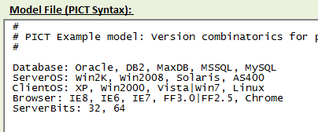
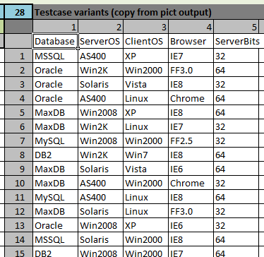
A simple All-Pairs Example
A simple All-Pairs Example: Version combinatorics of a platform test
Identify the parameters of the test and their potential values
Use a tool to generate the test case variants that guarantee 'all-pairs' coverage
Execute the test case variants (different parameter combinations)
1
3
2
Pairwise Generation Tool
https://pairwise.teremokgames.com/

Slide 32
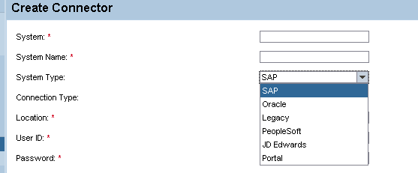
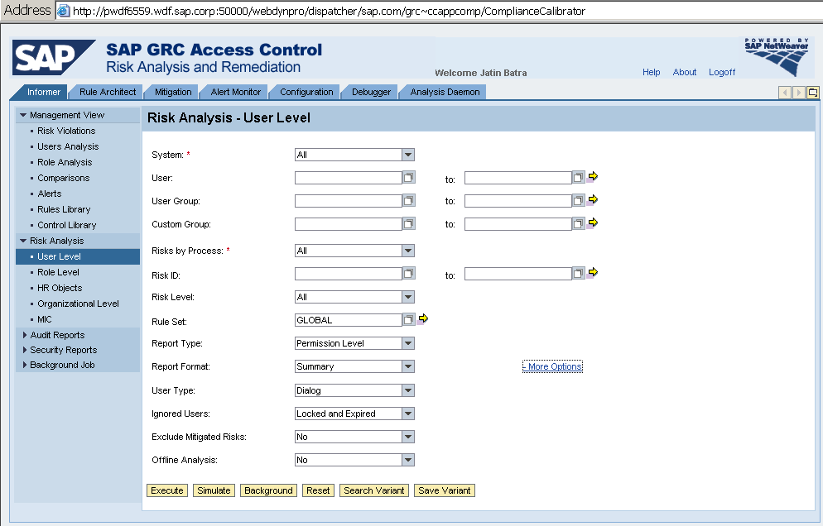
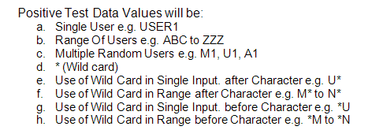
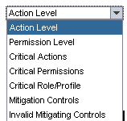
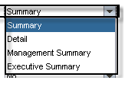
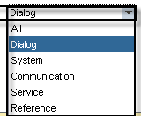
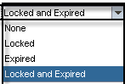

All-Pairs Testing: Input Parameters to Risk Reporting
properties of 'System'
150 actual systems in list
for User, User Group, Custom Group
RiskByProcess: "All" or specific process name
RiskID: "All" or specific risk ID(s)
RiskLevel: All, Critical, High, Medium, Low
RuleSet: "*", valid rule name, multiple rules
For all of these, wildcards are allowed

Slide 33
All Pairs Testing - Applicability
All-Pairs Testing is useful if …
… there are more than 4 parameters of a use case
… parameters are semi-coupled, i.e. there is some interaction possible ^{(*)}
Applicable Test Object Types
Testing at UI level / screens
APIs e.g. RFC, BAPI, SOA, …
Scenario tests with many steps and variants / parameters
Component and Version combinatorics (e.g. allowed combinations of OS, DB, browser, …)
Configuration e.g. EhP switches, ByD config
… (and more)

Slide 34
Is it worth it? ROI of All-Pairs Testing Pilots (Results from SAP – Internal Pilot 2009)
All-Pairs finds more defects with less effort
Average find-cost per defect ^{(*)} for All-Pairs was 1 P/h for a defect vs. ≈ 0.26 P/h for a defect in standard acceptance tests
➔ average is ≈ factor 4 better
some projects were actually 10x better
(*) Find-cost-per-defect = test-execution-effort / defects-found
Notes:
Is All-Pairs worth the extra effort in thinking and modeling? It certainly seems so.
This slide shows the results from an SAP internal pilot that used All-Pairs in 10 projects. These were a mix between totally new code and increments to existing products. In most of the cases, the All-Pairs test was done for maintenance hotspots, i.e. products that were already in the market for 1-2 years but where certain areas kept causing problems (continued flow of defect reports).
Note that most of these projects already had had their 'standard acceptance testing' done as well as 1-2 years in the market. In spite of all that 'prior test', All-Pairs found so many defects that the average 'find-cost-per-defect' using All-Pairs was 4x lower than the average AT find-cost. Some projects (3 out of 10) actually were 10x better! (see chart above). This means two things:
All-Pairs is clearly worth the effort – when the application case is suitable (>=4 parameters, semi-coupled, etc.)
The difference in find-cost may indicate additional factors that should be considered in judging a 'good application case' for All-Pairs. For example, the project that had the highest find-cost was a thin interface over rather old code ( > 10 years), i.e. what you actually test was the code behind the new interface. This of course finds less defects than when you apply All-Pairs on a public interface of brand-new code.
Microsoft has also done studies on the performance of All-Pairs. The link to the details slide above leads to several slides with results from Microsoft studies and others.

Slide 35
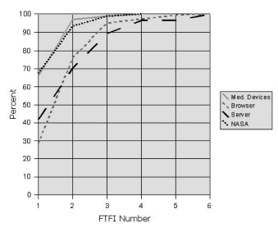
All-Pairs Testing – the Foundation
The Empirical Foundation
Most faults (70-90%) can be exposed / occur by combining two parameters 'just right' (proven by many studies)
All-Pairs Testing exploits this for testing: ➔ Generates minimal test case variants that cover all 'pair combinations'
All-Pairs is a proven industry best practice
Cumulative fault dependency on N parameters
Notes:
The foundation of the method is: Most faults can be exposed by setting just 2 parameters 'just right'. This is exploited in systematic test case generation that generates 'all pairs' of variable values.
What does this mean? Consider a function that takes 5 parameters with 3 values each (1,2,3). Then a defect may depend only on p2=3 and p4=5 (the defect is exposed by two parameters having the 'just the right value'). This means that the defect would be found by a test case that guarantees pair coverage, i.e. that guarantees that the combination (p2=3,p4=5) occurs somewhere in the test.
Article on empirical foundation:
A good article on the empirical foundation of all-pairs is (source of diagram above): Kuhn et al.: Software Fault Interactions and Implications for Software Testing, IEEE Trans. on Softw. Eng. 30 (6), June 2004
The article combines several research papers and sources and shows that the effectiveness of all-pairs is between roughly 70 and 90% in the investigated cases.

Slide 36
All-Pairs Testing – the Foundation
Article on empirical foundation:
A good article on the empirical foundation of all-pairs is (source of diagram in previous slide): Kuhn et al.: Software Fault Interactions and Implications for Software Testing, IEEE Trans. on Softw. Eng. 30 (6), June 2004
The article combines several research papers and sources and shows that the effectiveness of all-pairs is between roughly 70 and 90% in the investigated cases.

Slide 37
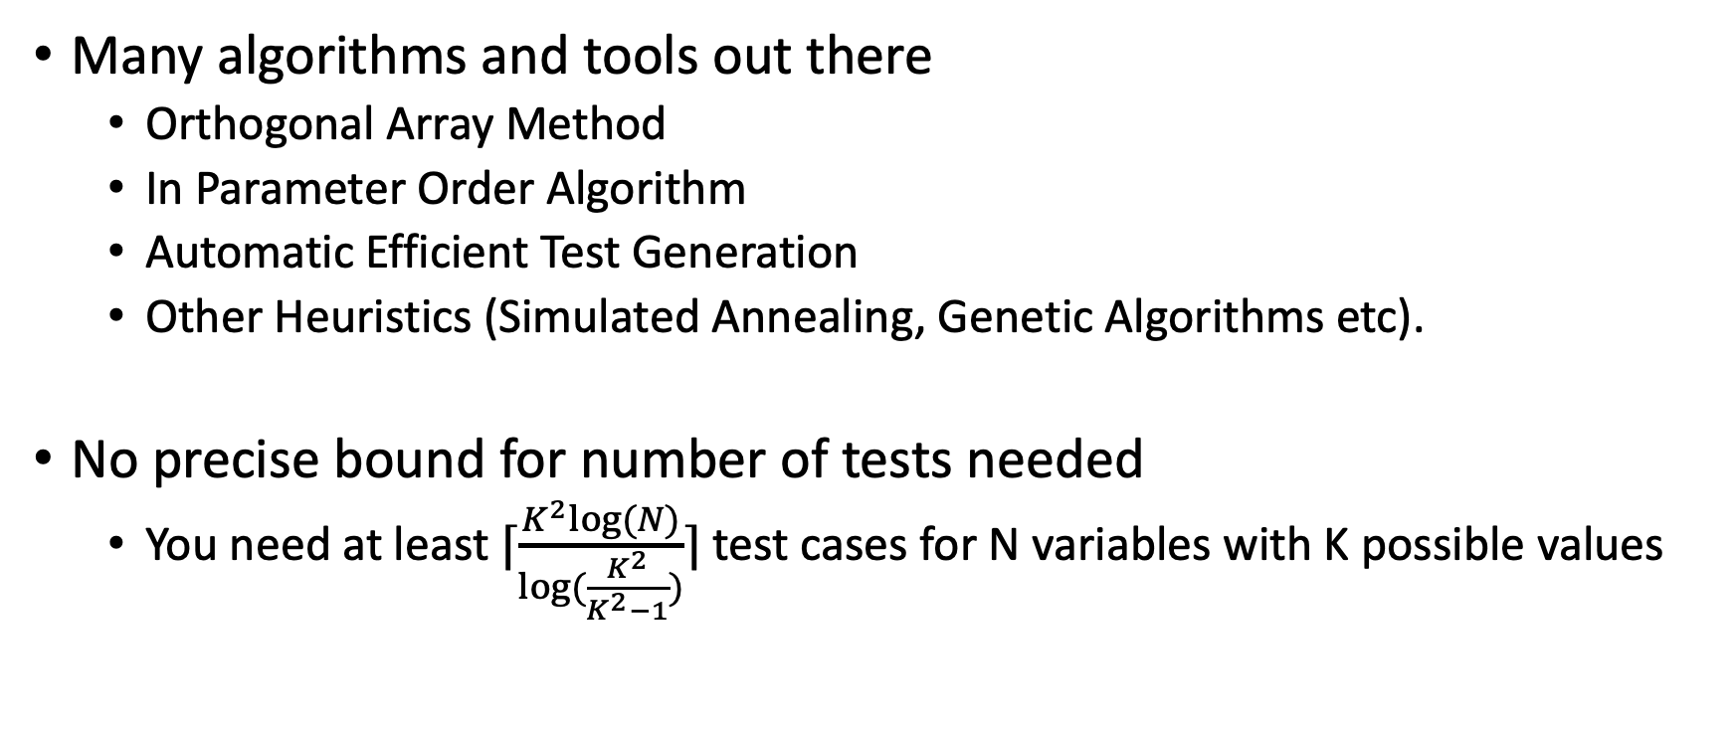
How to Generate All Pairs?
Many algorithms and tools out there
Orthogonal Array Method
In Parameter Order Algorithm
Automatic Efficient Test Generation
Other Heuristics (Simulated Annealing, Genetic Algorithms etc).
No precise bound for number of tests needed
You need at least ⌈$\frac{K^{2}log⁡(N)}{log⁡(\frac{K^{2}}{K^{2}−1})}$⌉ test cases for N variables with K possible values

Slide 38
A Simple Efficient Algorithm
pairs = generate_all_pairs(parameters) # N*(N-1)*K^2/2 pairs much less than N^K tests = [] # Empty set of tests to start with while pairs: # While there are uncovered pairs best_cand = None best_score = -1 for i in range(50): # Pick 50 random tests cand = generate_random_test(parameters) # Pick one test score = count_uncovered(cand, pairs) # Count how many of the remaining cases this test covers if score > best_score: # If it covers more than the best so far keep it best_score = score best_cand = cand tests.append(best_cand) # Found the best so far for pair in pairs: # Remove the pairs that the selected test case covers from the set if iscovered(cand, pair): pairs.discard(pair) return tests Hard to prove bounds, but it tends to run a bit slower while producing minimal number of test cases from other algorithms.

Slide 39
Fuzz Testing – aka Fuzzing
Commonly used in security settings:
Automatically generate random or slightly mutated (from an original set) set of inputs
Execute program with said inputs and monitor for abnormal behavior
Crashes
Memory corruption
Code injection
Exfiltration
….
Troubling inputs filed as bugs
Some of the most famous security bugs have been in browser code parsing images!!!

Slide 40
Fuzz Testing – aka Fuzzing
3 types of fuzzing
Black box fuzzing: No knowledge of source code, just random inputs
White-box fuzzing: Use program analysis to generate targeted inputs
Grey-box fuzzing: Use access to code and instrumentation (but not full code analysis) to determine if new inputs trigger new paths. Then keep those inputs as candidates for further mutations.

Slide 41


Readings , Assignments, Project Tasks
Read:
Chapters 16, 17, 18, 19, 20 of the textbook.
Assignments & Project Tasks:

Slide 42

Questions?

